Slide 1
Resubmission folder
Not for assignments you missed
If the original has closed, you should not be submitting here unless you talk to me
Reasonable time after the assignment was graded, no more than a week after grade is posted
Need to identify which assignment you are submitting. Most I can figure out but some, not sure which one it is for.

Slide 2
Generics

Slide 3
Generics?
Capability to parameterize types.
Can define a class or a method with generic types that can be substituted using concrete types by the compiler.
Generic type must be a reference type
Define a generic ArrayList class that stores the elements of a generic type.
Create an ArrayList object for holding strings
Create an ArrayList object for holding numbers.

Slide 4
Why Generics?
Enables types to be parameterized and used as formal parameters
Errors will be detected at compile time rather than at runtime.
Specify allowable types of objects that the class or method may work with.
Attempt to use the class or method with an incompatible object, a compile error occurs.
Add stability to code by using type checking

Slide 5
Why Generics?
Eliminates casts which can cause errors
Without Generics and types, had to cast
Comparable without type
Must cast to type to be compared
Improper cast will cause runtime errors

Slide 6
Generic Type
Generic Instantiation
Runtime error
Improves reliability
Compile error

Slide 7
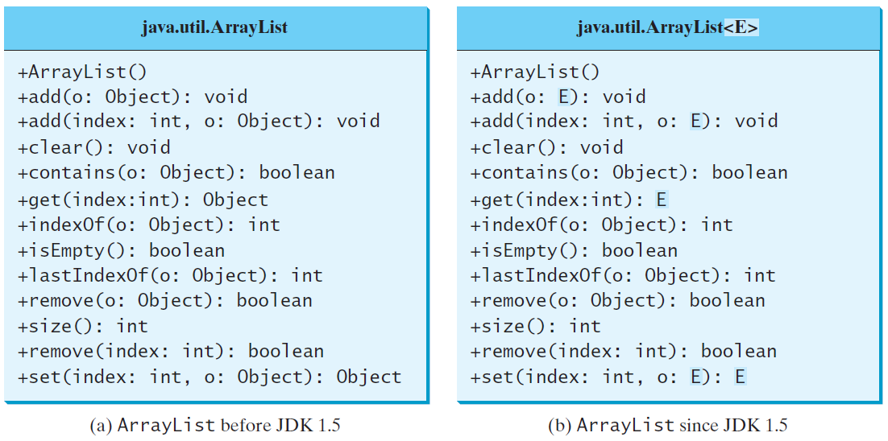
Generic ArrayList in JDK 1.5

Slide 8
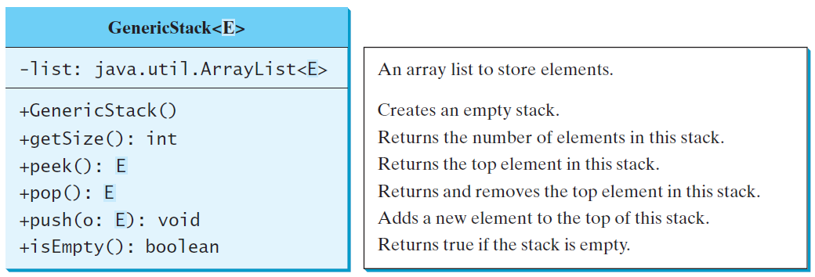
Declaring Generic Classes and Interfaces
Notes:
Can define a class to work on a generic type.
Replaced with concrete types when used.
Allows compiler to do type checking
Use of an incompatible type will through a compile error

Slide 9
Generic Methods
public class GenericPrint
{
public <T> void print(ArrayList<T> list)
{
for (int index = 0; index < list.size(); index++)
System.out.println(list.get(index) );
}
}
ArrayList<String> myStrings = new ArrayList<String>();
ArrayList<Integer> myInts = new ArrayList<Integer>();
.
.
GenericPrint gp = new GenericPrint();
gp.print(myStrings);
gp.print(myInts);
Notes:
Can only be defined for static methods
To use, prefix the method name with the type in the call.

Slide 10
Bounded Generic Type
public static void main(String[] args )
{
Rectangle rectangle = new Rectangle(2, 2);
Circle circle = new Circle (2);
System.out.println("Same area? " + equalArea(rectangle, circle));
}
public static <E extends GeometricObject> boolean
equalArea(E object1, E object2)
{
return object1.getArea() == object2.getArea();
}

Slide 11
Raw Type and Backward Compatibility
// raw type
ArrayList list = new ArrayList();
This is roughly equivalent to
ArrayList<Object> list = new ArrayList<Object>();

Slide 12
Raw Type is Unsafe
// Max.java: Find a maximum object
public class Max
{
/** Return the maximum between two objects */
public Comparable max(Comparable o1, Comparable o2) {
if (o1.compareTo(o2) > 0)
return o1;
else
return o2;
}
}
Runtime Error:
Max.max("Welcome", 23);

Slide 13
Make it Safe
// Max1.java: Find a maximum object
public class Max1
{
/** Return the maximum between two objects */
public <E extends Comparable<E>> E max(E o1, E o2) {
if (o1.compareTo(o2) > 0)
return o1;
else
return o2;
}
}
Max.max("Welcome", 23);

Slide 14
Erasure and Restrictions on Generics
Implemented using type erasure
Compiler uses the generic type information to compile the code
Erases this information afterwards.
Generic information is not available at run time.
Enables the generic code to be backward-compatible with the legacy code that uses raw types.

Slide 15
Compile Time Checking
For example, the compiler checks whether generics is used correctly for the following code in (a) and translates it into the equivalent code in (b) for runtime use. The code in (b) uses the raw type.

Slide 16
Important Facts
It is important to note that a generic class is shared by all its instances regardless of its actual generic type.
GenericStack<String> stack1 = new GenericStack<>();
GenericStack<Integer> stack2 = new GenericStack<>();
Although GenericStack<String> and GenericStack<Integer> are two types, but there is only one class GenericStack loaded into the JVM.

Slide 17
Restrictions on Generics
Cannot Create an Instance of a Generic Type.
(i.e., new E()).
Generic Array Creation is Not Allowed.
(i.e., new E[100]).
Generic Type Parameter of a Class Is Not Allowed in a Static Context.
All instances of generic class have same runtime class
All static variables and methods shared
Cannot refer to the class generic
public class MyClass<T>
Can’t refer to T in a static method/variable declaration
Exception Classes Cannot be Generic.
Exception would need to know type of argument
This is not present due to Erasure

